Slide 1
Predicting Indian Monsoon Rainfall
Approach using NumPy and Linear Regression
By Ankit Prajapati | CC25MTECH11005
Notes:
1

Slide 2


1. Project Objective:
The core goal of this project was to build a simple machine learning model to predict seasonal Indian monsoon rainfall (June - September).
Target Variable (Y)
Summer Rainfall: Total seasonal precipitation over India.
Features (X)
Winter SST: Sea Surface Temperature (Dec - Feb) from the Pacific and Indian Oceans.
The primary objective was to build the entire model implementation—from data preparation to training and evaluation—using numpy exclusively. This constraint was imposed to ensure a deep, non-abstracted understanding of the full data science pipeline.
Notes:
2

Slide 3
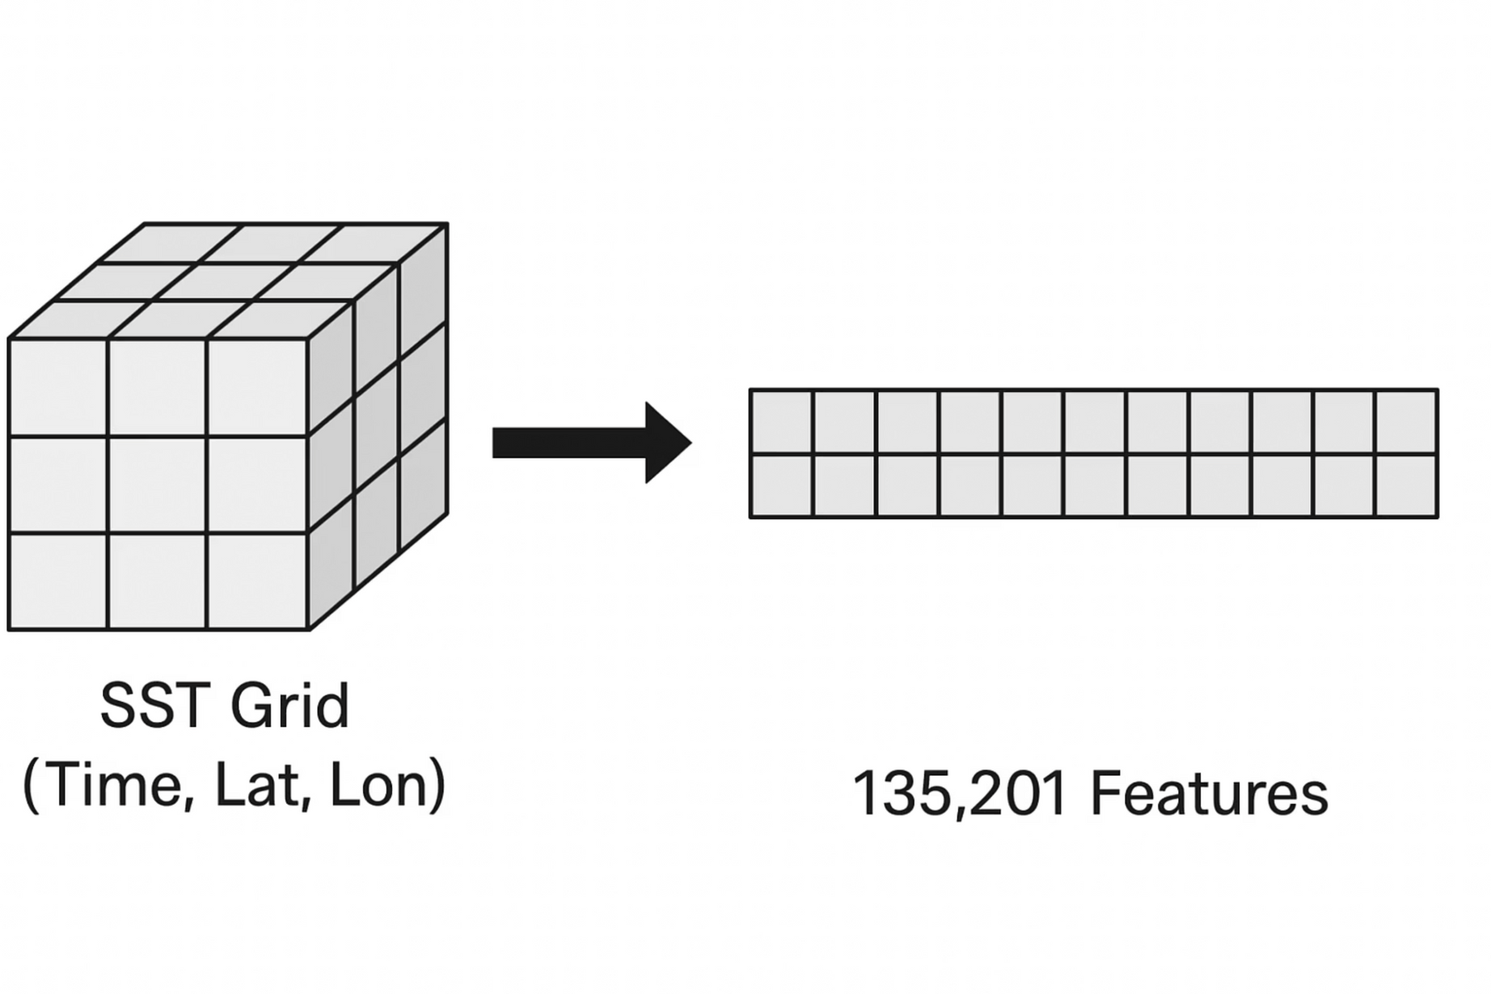
2. The Data & Initial Challenge: Too Many Features
The Climate Data Used
  Rainfall (Y): Data from 1961-2020. We averaged it to get one rainfall number for each year (total 60 years).
  SST (X): Sea Surface Temperature data from 1960-2020. This data came as a 3D grid: (time, latitude, longitude).
Challenge: Too Many Features!
When we tried to flatten the 3D SST data into a simpler list for our model, we ended up with a huge problem. We had 135,201 features (like individual pixels) but only 60 samples (years of data). This was way too much data for our computer to handle, causing a MemoryError.
Notes:
3

Slide 4
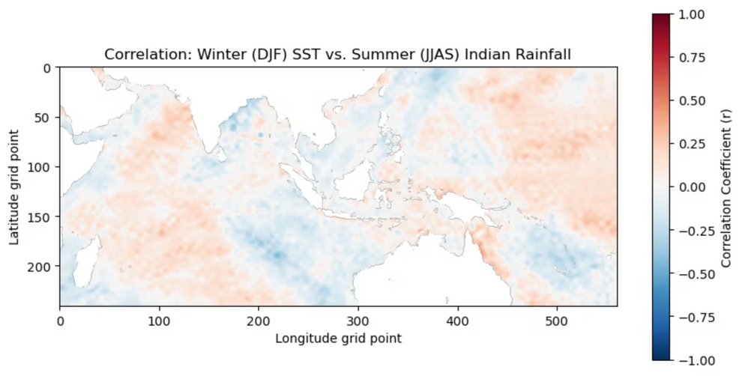
3. Solution (Part 1): Exploring the Data
Finding the Important Areas
To fix the computer memory problem, I needed to find only the few ocean areas (SST regions) that really affected the monsoon, instead of using all 135,000 grid points.
  I used a simple computer script (numpy loop) to check how well the 60-year rainfall data matched up with the temperature data from each single ocean grid point.
  I put all these results into a new map, called the Correlation Map.
  This map uses colors to show how strongly things are connected (from -1.0 to +1.0). It clearly showed the most important ocean areas, like the red spot in the central Pacific linked to El Niño.
Notes:
4

Slide 5
4. Solution (Part 2): Strategic Feature Selection
1. Filter by Correlation
The correlation map showed that huge parts of the ocean had almost no connection to the monsoon ("noise"). We only needed the areas with the strongest signal.
2. Identify Top Indices
I used np.argsort() on the correlation numbers to find the most important points.
3. Final Feature Set
I picked the Top 100 points (pixels) with the strongest connection. This cut down the number of features from 135,201 to just 100, fixing the memory problem.
Notes:
5

Slide 6
5. The Model: Linear Regression (Implemented with NumPy)
Instead of using an external library, the standard linear regression model was implemented directly using the Normal Equation.
Training the Model
The Normal Equation provides a direct way to find the best set of weights (theta) for our model. This minimizes the error (Residual Sum of Squares, RSS).
This means we can calculate the answer directly without needing to try different values over and over, like with Gradient Descent.
Data Splitting
To fairly check how well our model predicts new data, we split the 60 years of data into two parts:
  Training Set: 1961 - 2005 (This data was used to find the theta values).
  Test Set: 2006 - 2020 (This data was used to see how well the model works on data it hasn't seen before).
Notes:
6

Slide 7
6. Challenge #2: The Singular Matrix Problem
The LinAlgError
The code was changed to look like this:
Even with fewer features (down to 100), the model still failed. It showed a LinAlgError: Singular matrix error when trying to do the matrix math for the Normal Equation.
# The fix for the LinAlgErroralpha = 500identity = np.eye(N)inverse_matrix = np.linalg.inv(X_dot_XT + identity * alpha)
This happened because the 100 features were too similar to each other (this is called multicollinearity). When features are too similar, the matrix cannot be 'inverted', which stops the calculation.
The Solution: Ridge Regularization
To make the calculation work, I added a technique called Ridge Regularization.
How it fixes it
A small extra number (called alpha) is added to the main diagonal of the matrix. This makes sure the matrix can be inverted, so the model can find a stable answer.
After some testing, I found that an alpha value of 500 worked best.
Notes:
7

Slide 8
7. Final Results: Evaluating Predictive Skill
The regularized linear model was trained on data from 1961-2005 and tested on data from 2006-2020.
About the R^2 Score
We calculated the R^2 score. It tells us how much of the rainfall changes our model can explain using sea surface temperatures (SST).
  If R^2 = 0: Our model isn't predicting anything better than just using the historical average.
  If R^2 > 0: Our model has some ability to predict.
Final R^2 Score: 0.087
This score is positive, even if it's a small number. It means our model found a real connection between winter SST patterns and summer monsoon rain.
Notes:
8

Slide 9
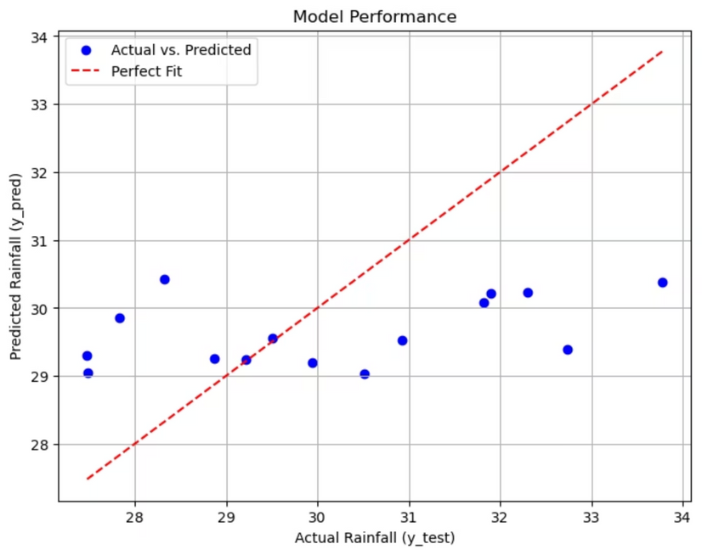
8. Result Visualization: Actual vs. Predicted Rainfall
Interpreting the Scatter Plot
  The X-axis shows the observed (actual) rainfall for the 2006-2020 test years.
  The Y-axis shows the rainfall predicted by the model.
  The Red Dashed Line represents a "Perfect Fit" (where Actual = Predicted).
The blue dots on the graph generally follow an upward trend, which shows that our model has some success in predicting rainfall. It's not a perfect match to the red line, but the positive R^2 score of 0.087 means our model is better than just random guesses based on the historical average.
Notes:
9

Slide 10
9. Conclusion & Key Takeaways
The final 0.087 suggests that while winter SST has a detectable relationship with monsoon rainfall, a simple linear model is insufficient to model the highly complex, non-linear dynamics of the climate system. However, the success lies in the execution of the core objective.
Data Handling
Successfully prepared and manipulated large, multi-dimensional climate datasets (3D .nc files) using numpy.
Signal Detection
Used Correlation Maps as an EDA technique to visually locate and extract the most significant features from over 135,000 candidates.
Model Implementation
Built and trained the entire Linear Regression model from scratch via the Normal Equation.
Debugging & Stability
Successfully debugged the critical LinAlgError by implementing and tuning Ridge Regularization (L2 Penalty).
The project proved that a deep understanding of the mathematical foundation (linear algebra) is crucial for effective machine learning development, even before advanced algorithms are applied.
Notes:
10

Slide 11
“Thank You”

